Slide 1

DIVING DEEP INTO PREDICTIVE TUNING-
A CASE STUDY WITH HEART DISEASE PATIENTS
Amardeep Singh
Matthew Law

Slide 2


DATA IMPORTANCE
BETTER VALIDATED DATA
POORLY VALIDATED DATA

Slide 3
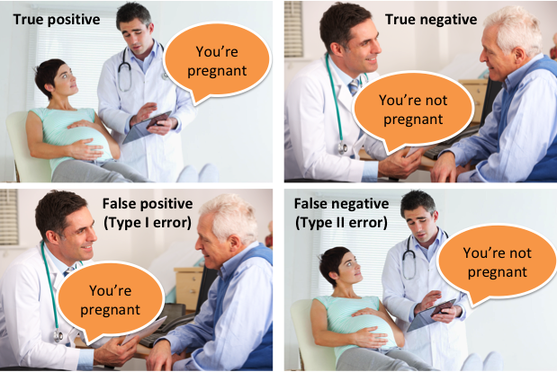
ERRORS AND EFFECTS

Slide 4
Objective And Questions
What are the best predictors that can be used for a given model?
What models produce the best accuracies for testing and validation?
What additional features can be built from existing columns?
What are the feature importance for the parameters in the models?
Can certain features be neglected to improve model accuracy?
Can these metrics be used in improving biosensors and personal machines?

Slide 5
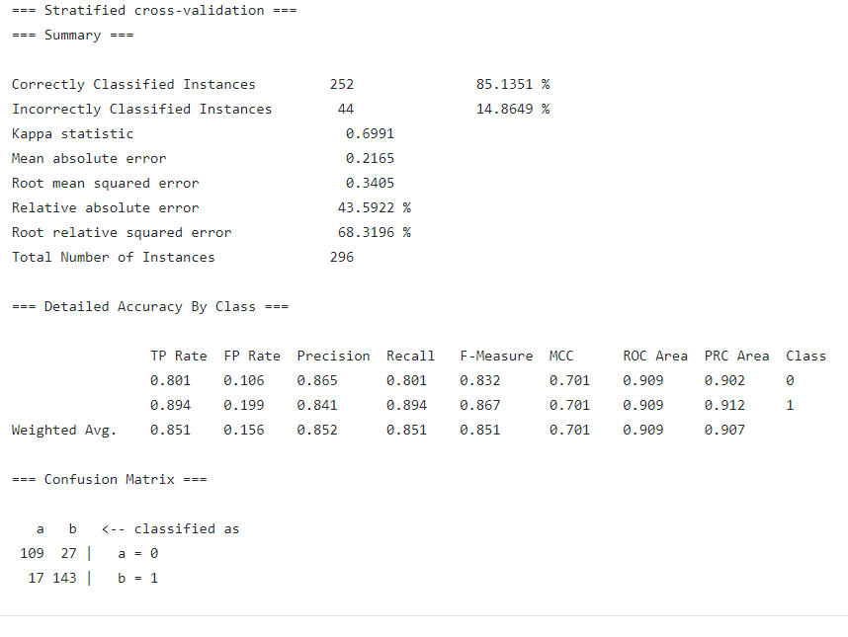
Algorithms
SVM - Support Vector Machines
SVM - Support Vector Machines
Algorithm | Software
Logit | Weka
SGD
SMO
SVC | Python
SVM
LR
Top 3
Algorithm | Precision Rate (%)
SGD | 85.1351
SMO | 84.7973
Logit | 83.7838

Slide 6
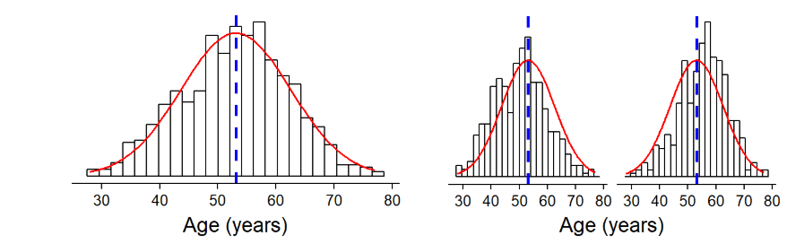
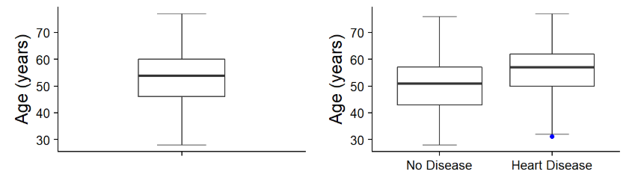
Age vs. Likelihood of Heart Disease
M
F

Slide 7
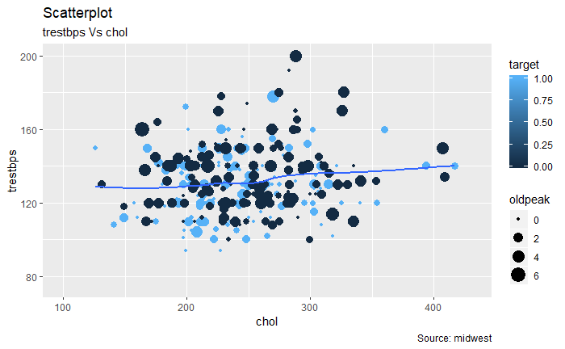
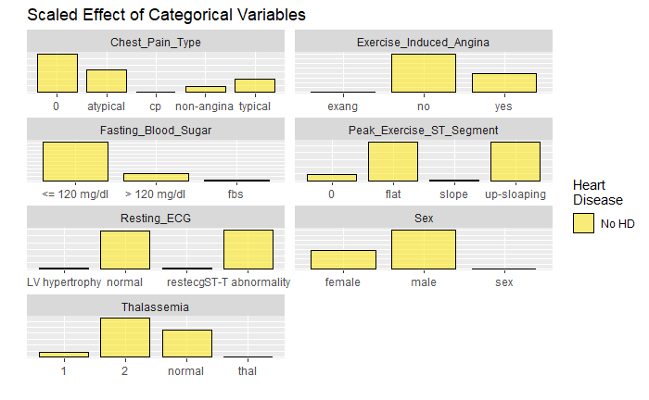
Correlation Plot

Slide 8
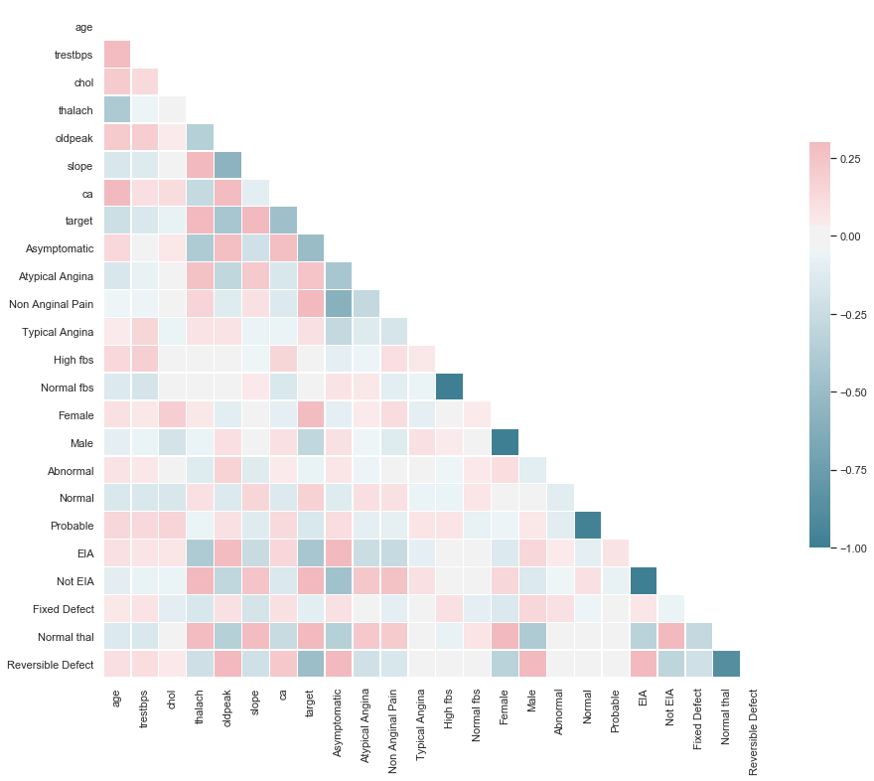
Correlation Plot

Slide 9
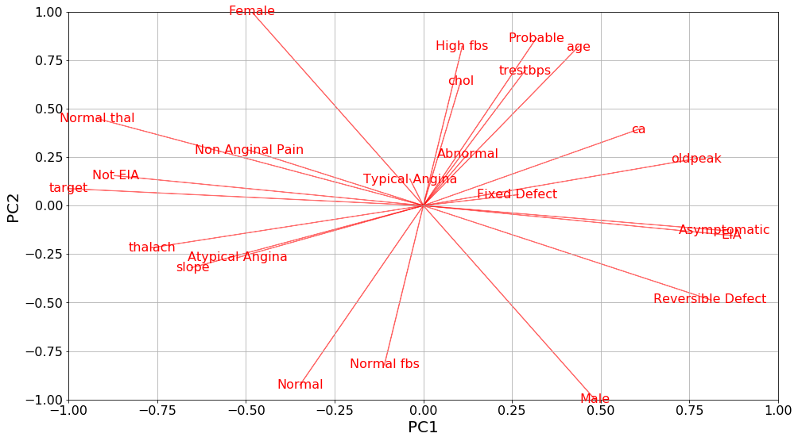
PCA Tests

Slide 10
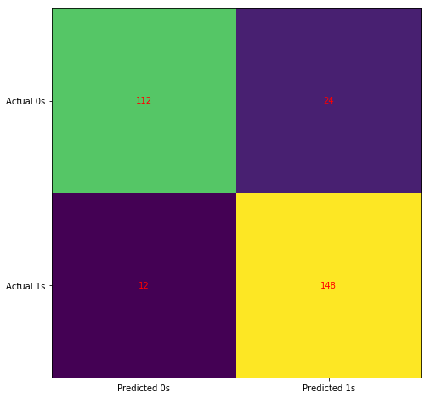
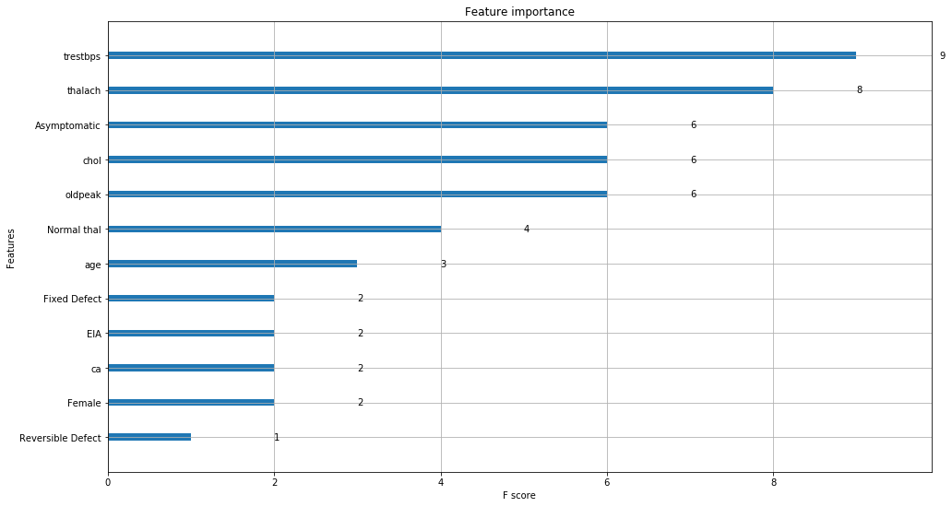
Logistic Regression – Confusion Matrix

Slide 11
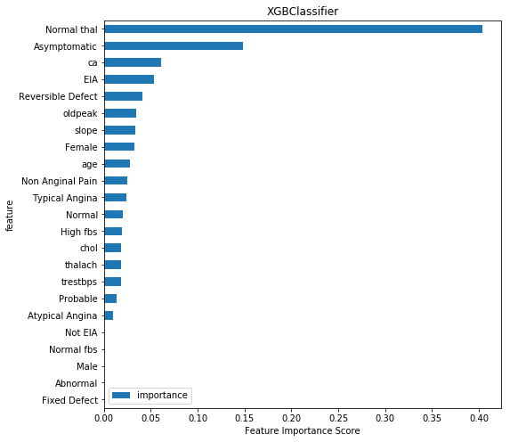
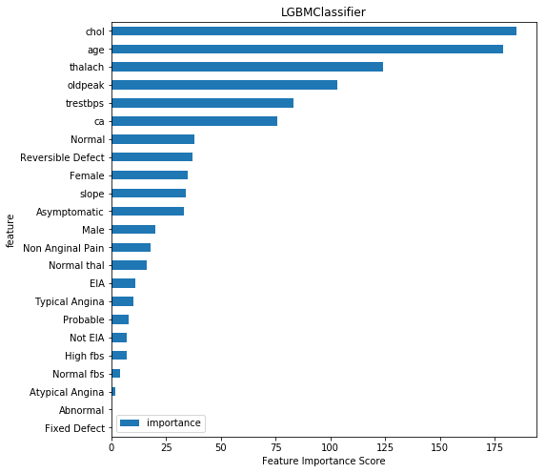
Comparing Feature Importance

Slide 12
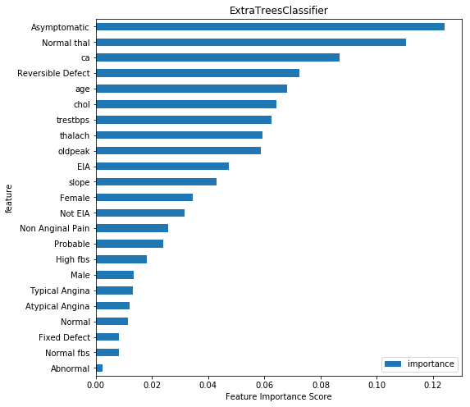
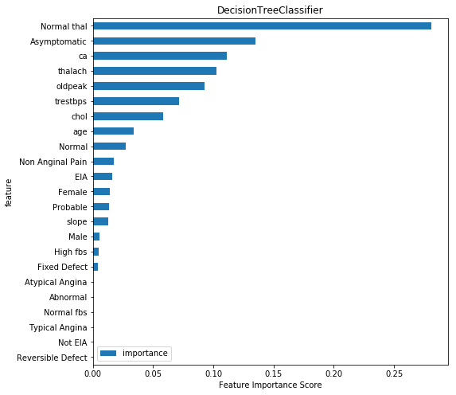
Comparing Feature Importance

Slide 13
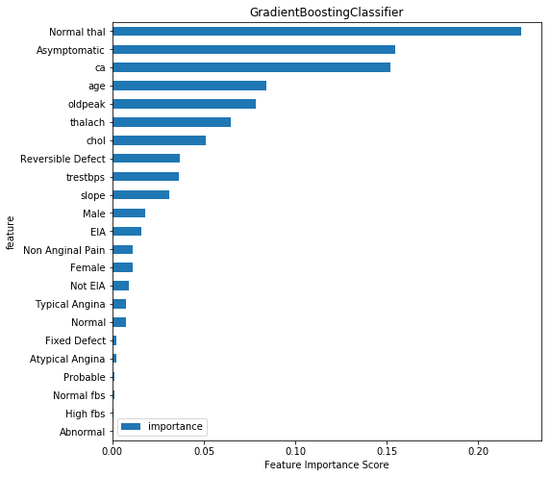
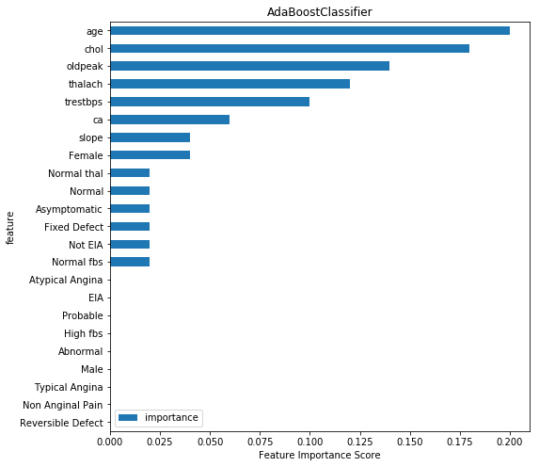
Comparing Feature Importance

Slide 14
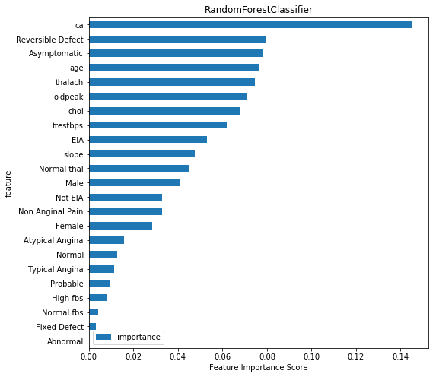
Comparing Feature Importance

Slide 15
Tuning the Model
Removed Parameters
CA (number of major vessels) feature was removed due to the large proportion (> 60%) of missing values
Rows containing missing values in multiple columns were also removed since they comprised only a small proportion of the dataset (i.e. 6%).
Most Significant Parameters
-patient age, cholesterol level, maximum heart rate, ST peak depression induced by exercise and slope of the peak exercise ST segment, gender, exercise induced angina, Electrocardiographic results, and ββ-Thalassemia diagnosis

Slide 16
Conclusion
Logistic regression proves to be the best predictor
Certain attributes (age and gender) tend to be uncorrelated to output.
The best results measured by AUC and accuracy are obtained from a logistic regression model (AUC 0.92, Accuracy 0.87), followed by Gradient Boosting Machines.
From a set of 14 variables, the most important to predict heart failure are whether or not there is a reversable defect in Thalassemia.
The second most important feature was whether or not there is an occurrence of asymptomatic chest pain.
Biosensing machines and personal devices can link these parameters while tuning models to better detect the occurrence of such diseases.

Slide 17
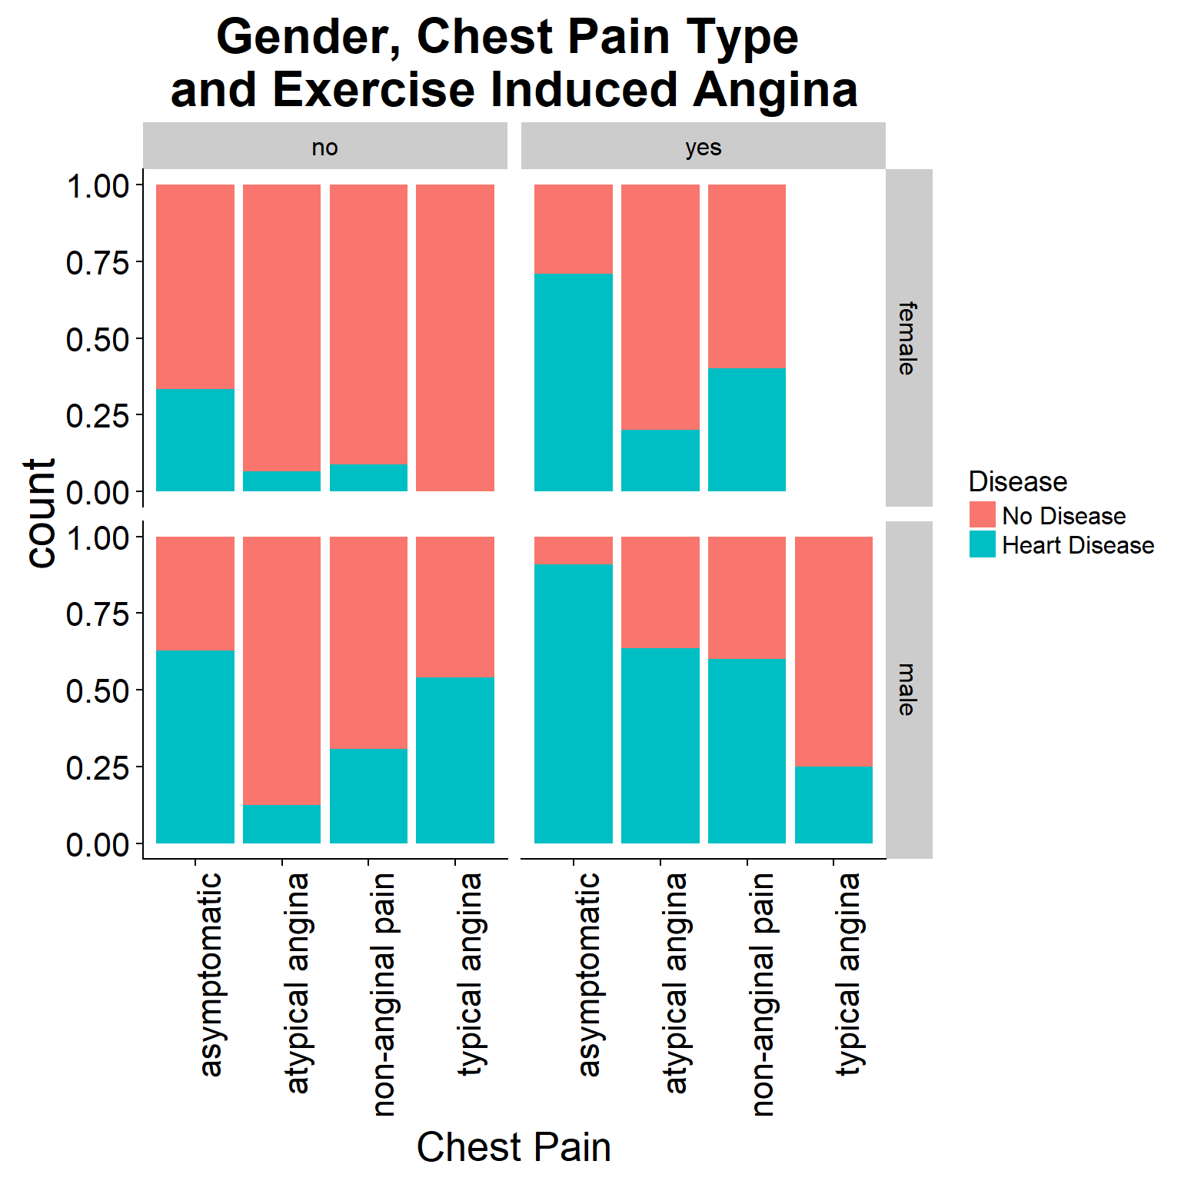
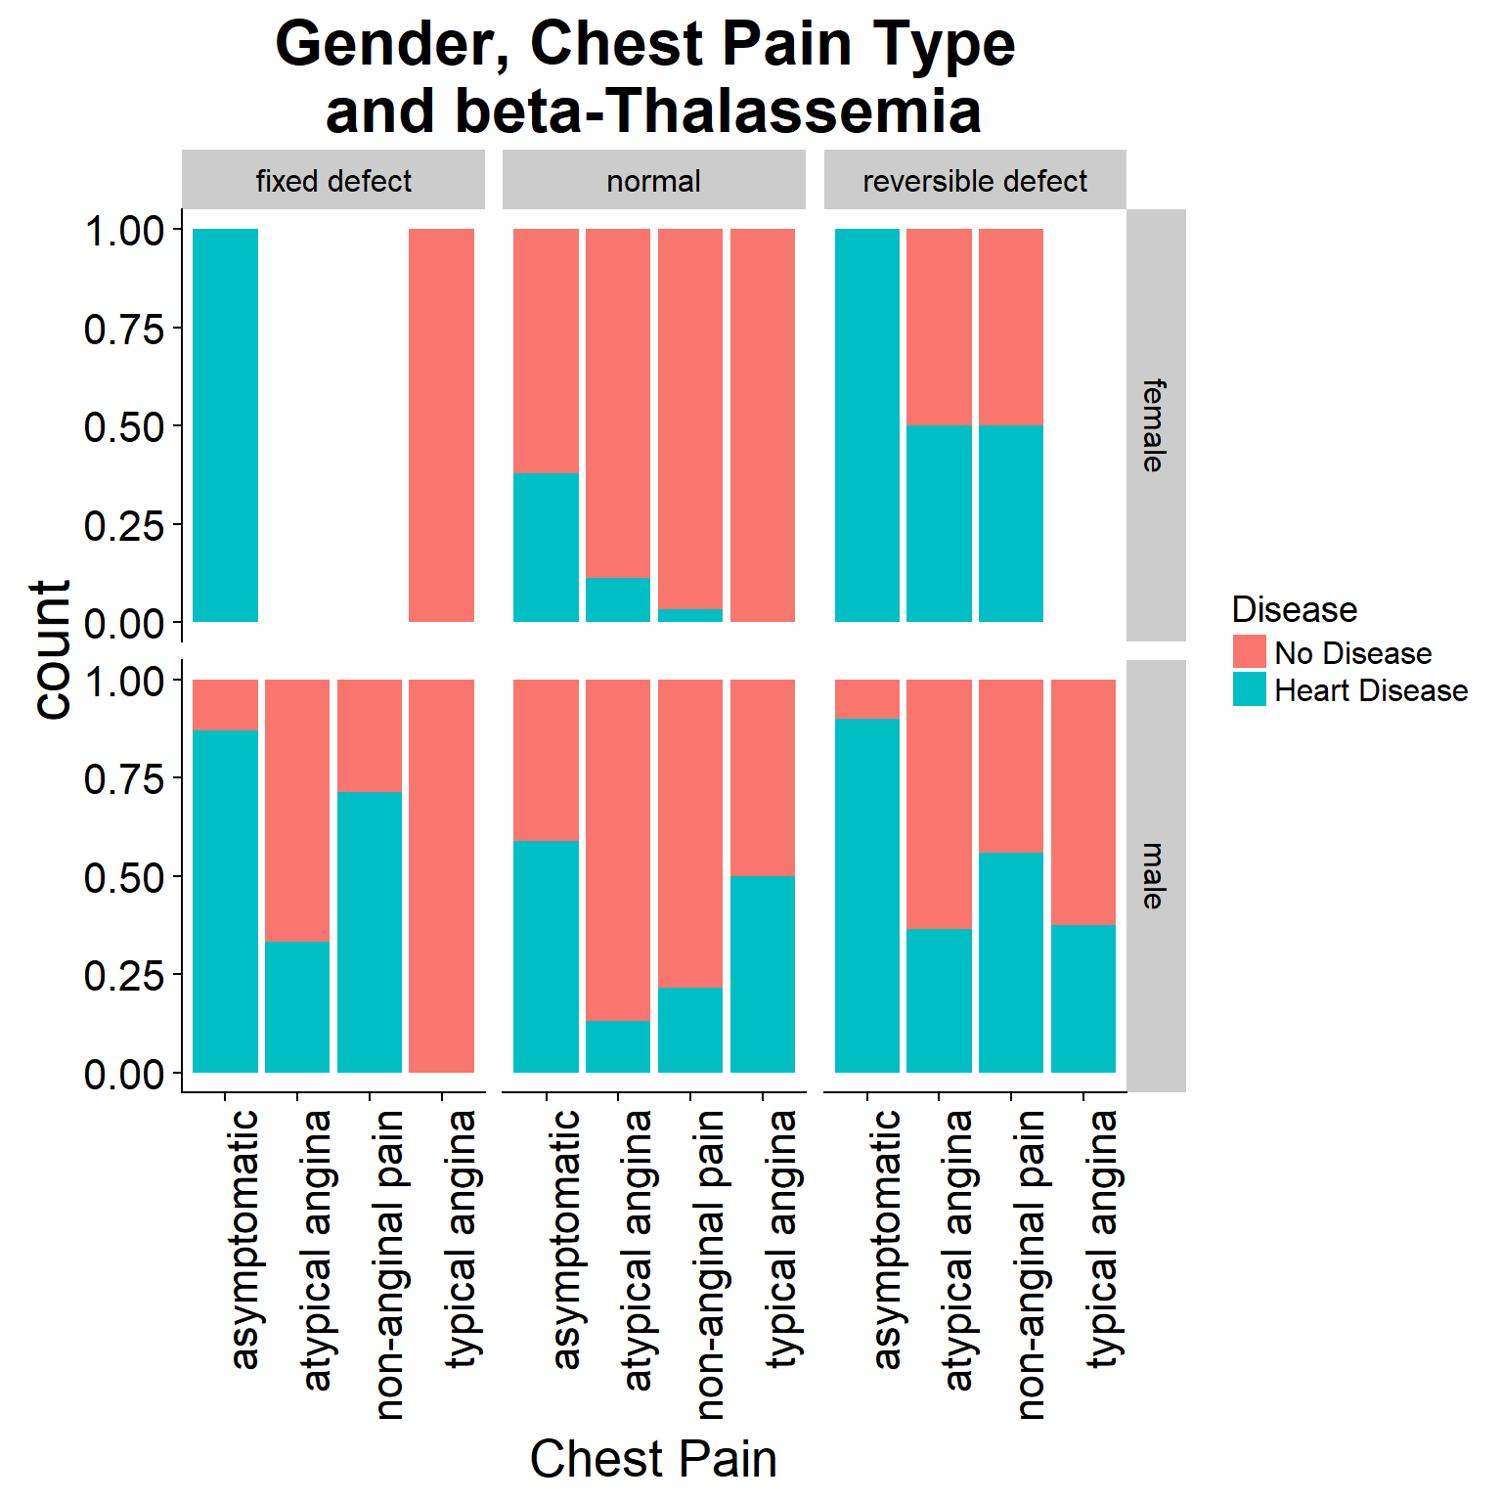
Appendix

Slide 18
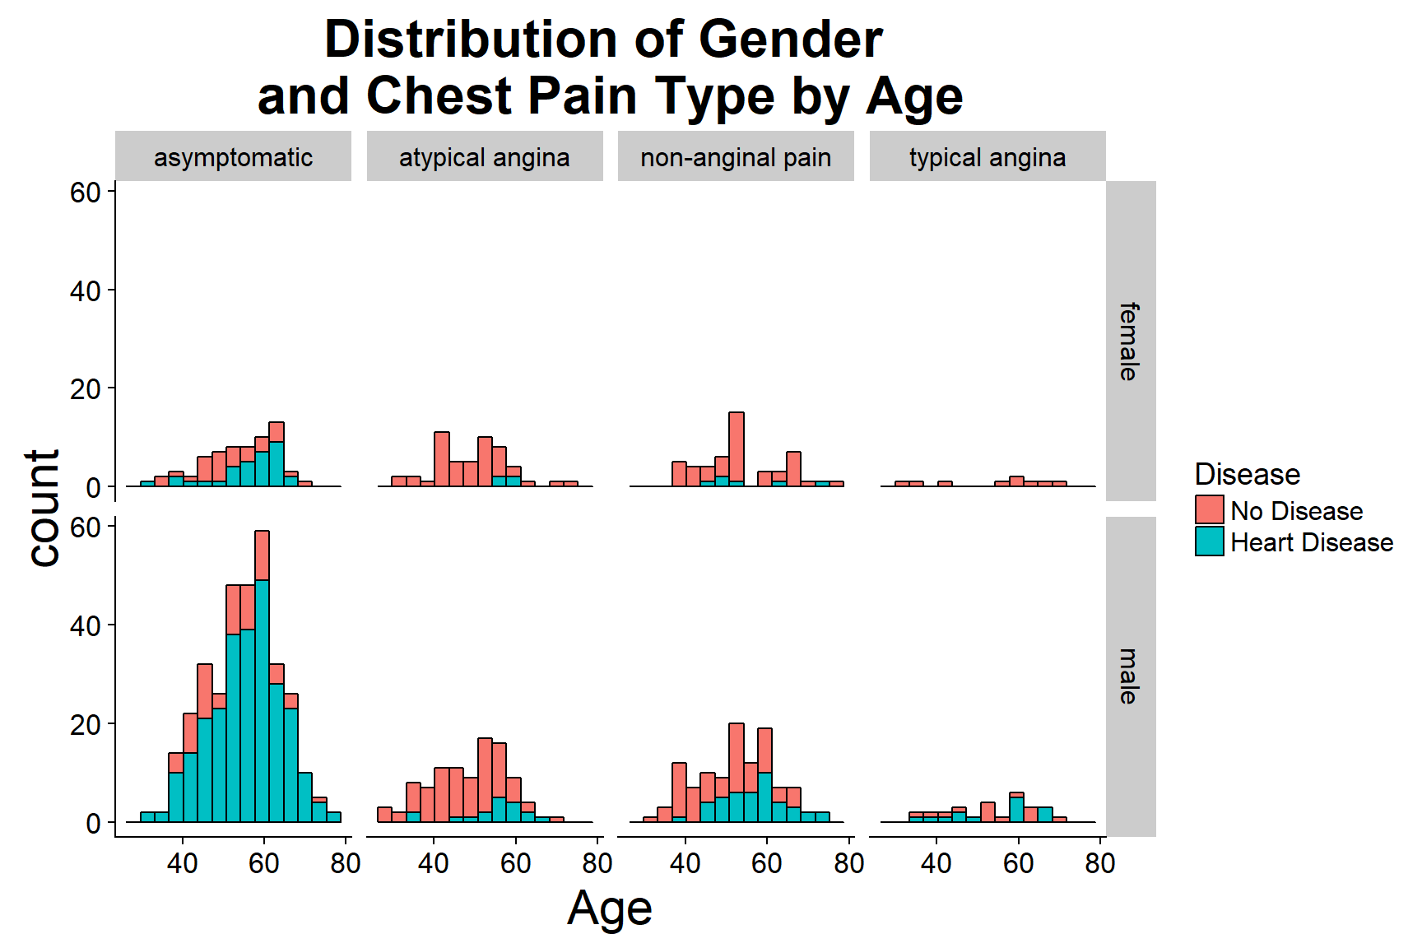
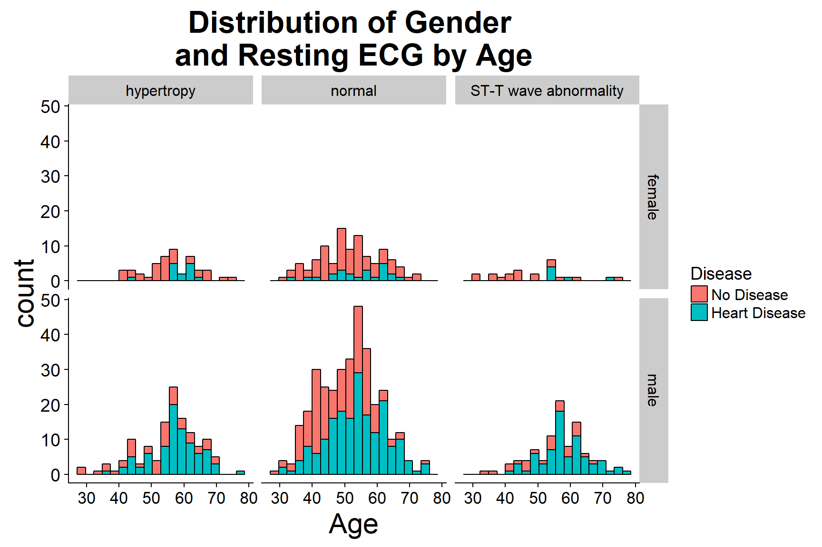
Appendix

Slide 19
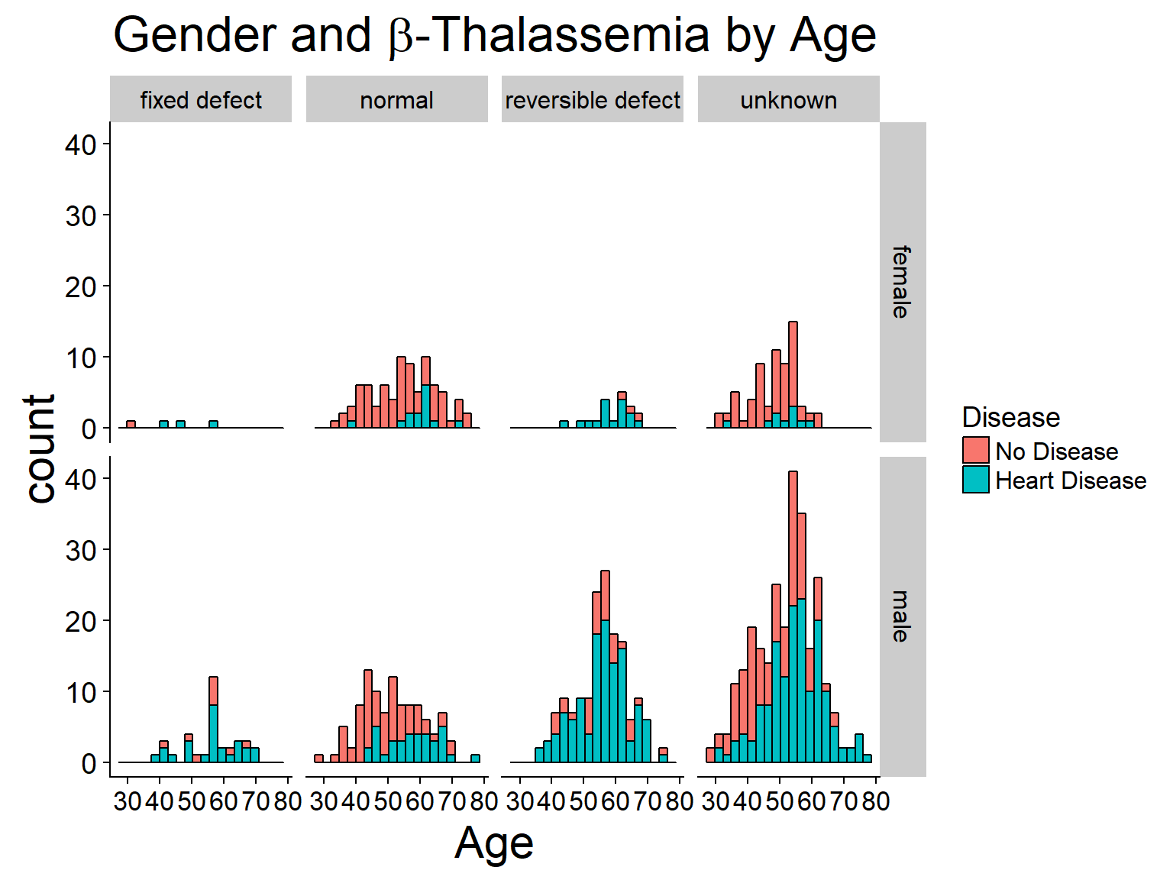
Appendix

Slide 20
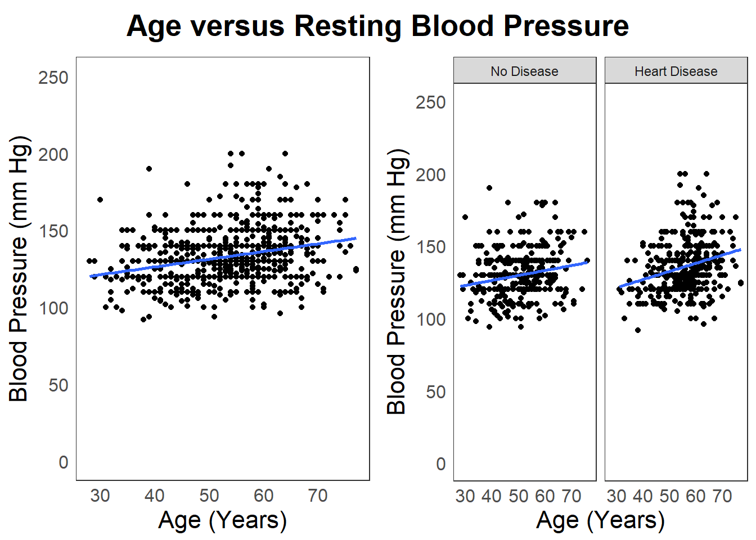
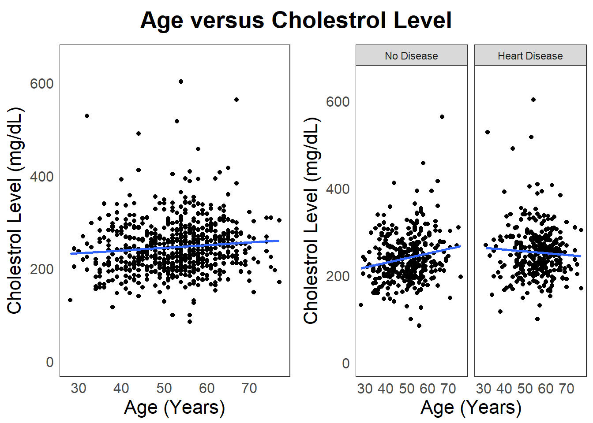
Appendix

Slide 21
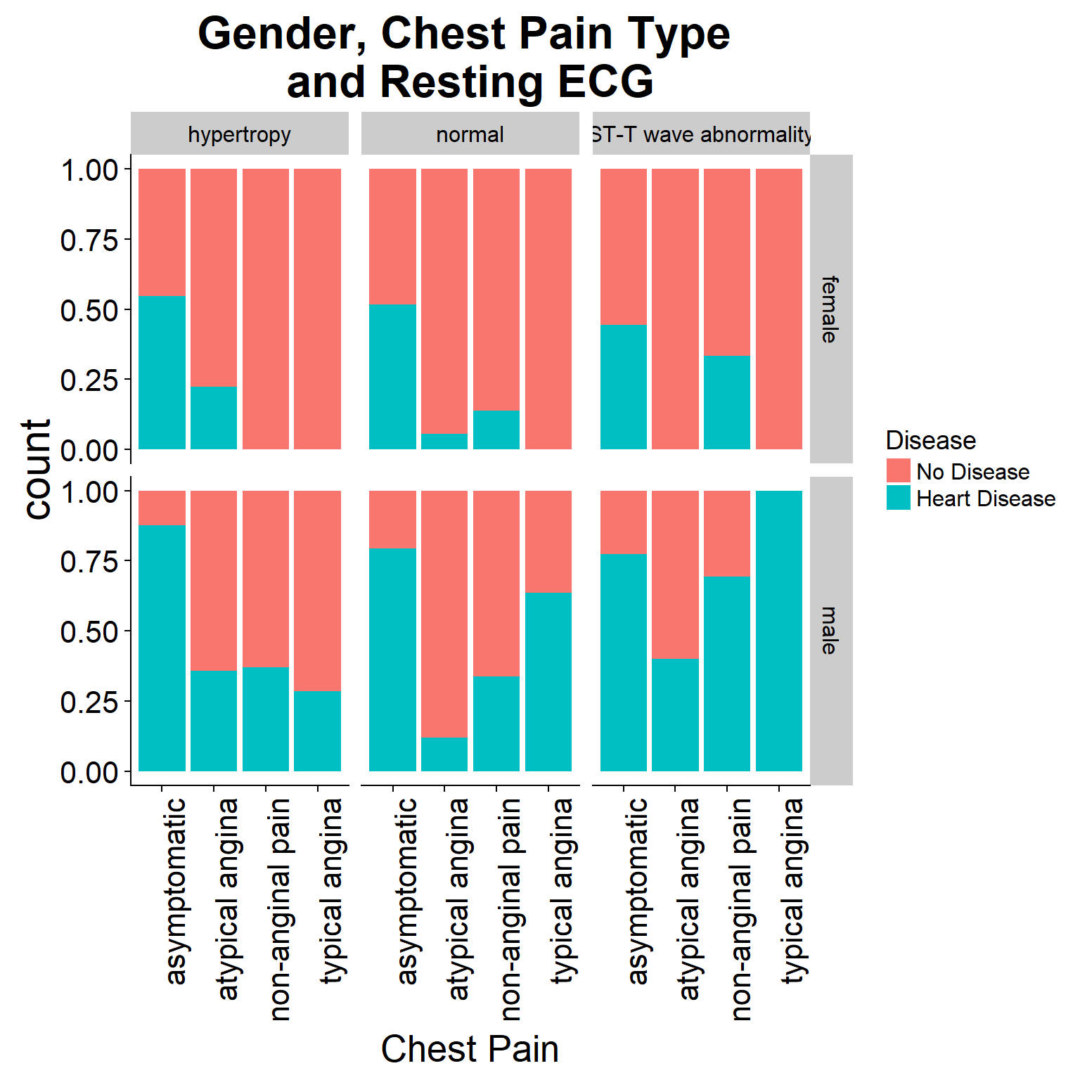
Appendix

